Slide 1
Event Kick Off

Slide 2

Welcome To the first Global Power Platform Bootcamp

Slide 3
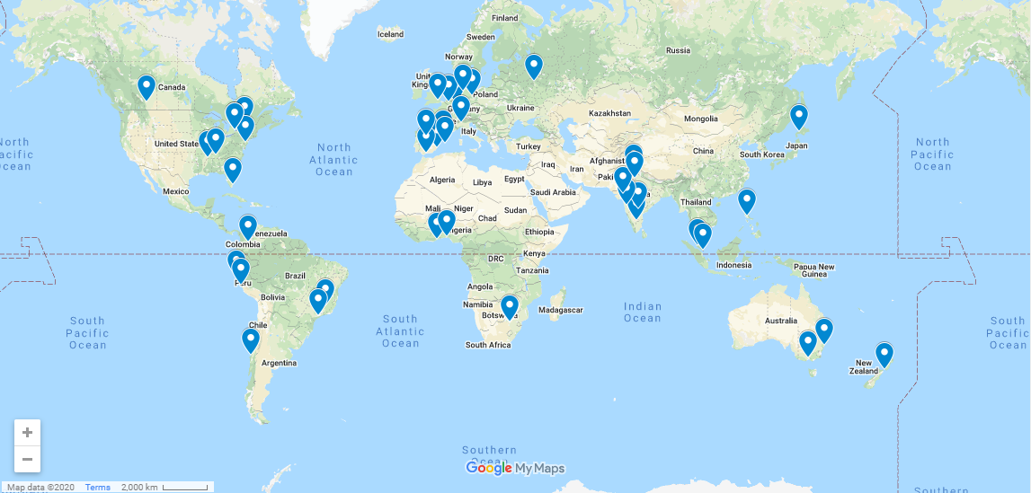
44 Locations Across the world!

Slide 4
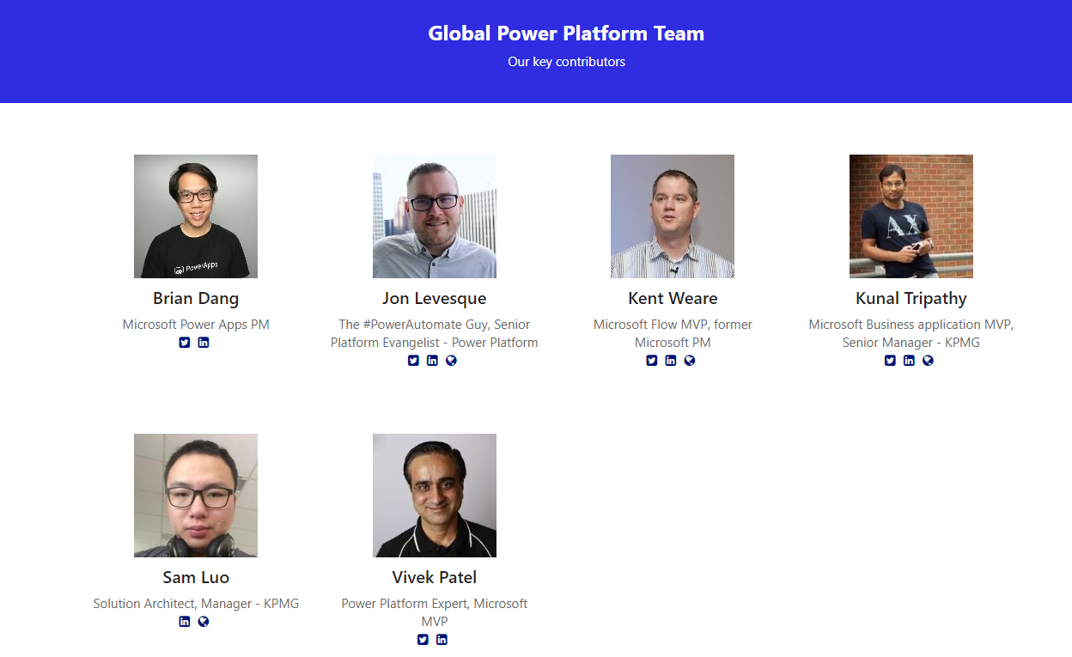
Notes:
Lets Hear from Them!!

Slide 5

Notes:
Lets Hear from the Global Team, Play video(only works in presentation mode), If any issues with video play it from here: https://www.youtube.com/watch?v=ZnLoqP6VIko&feature=youtu.be

Slide 6


Thanks To Our Global Sponsor

Slide 7

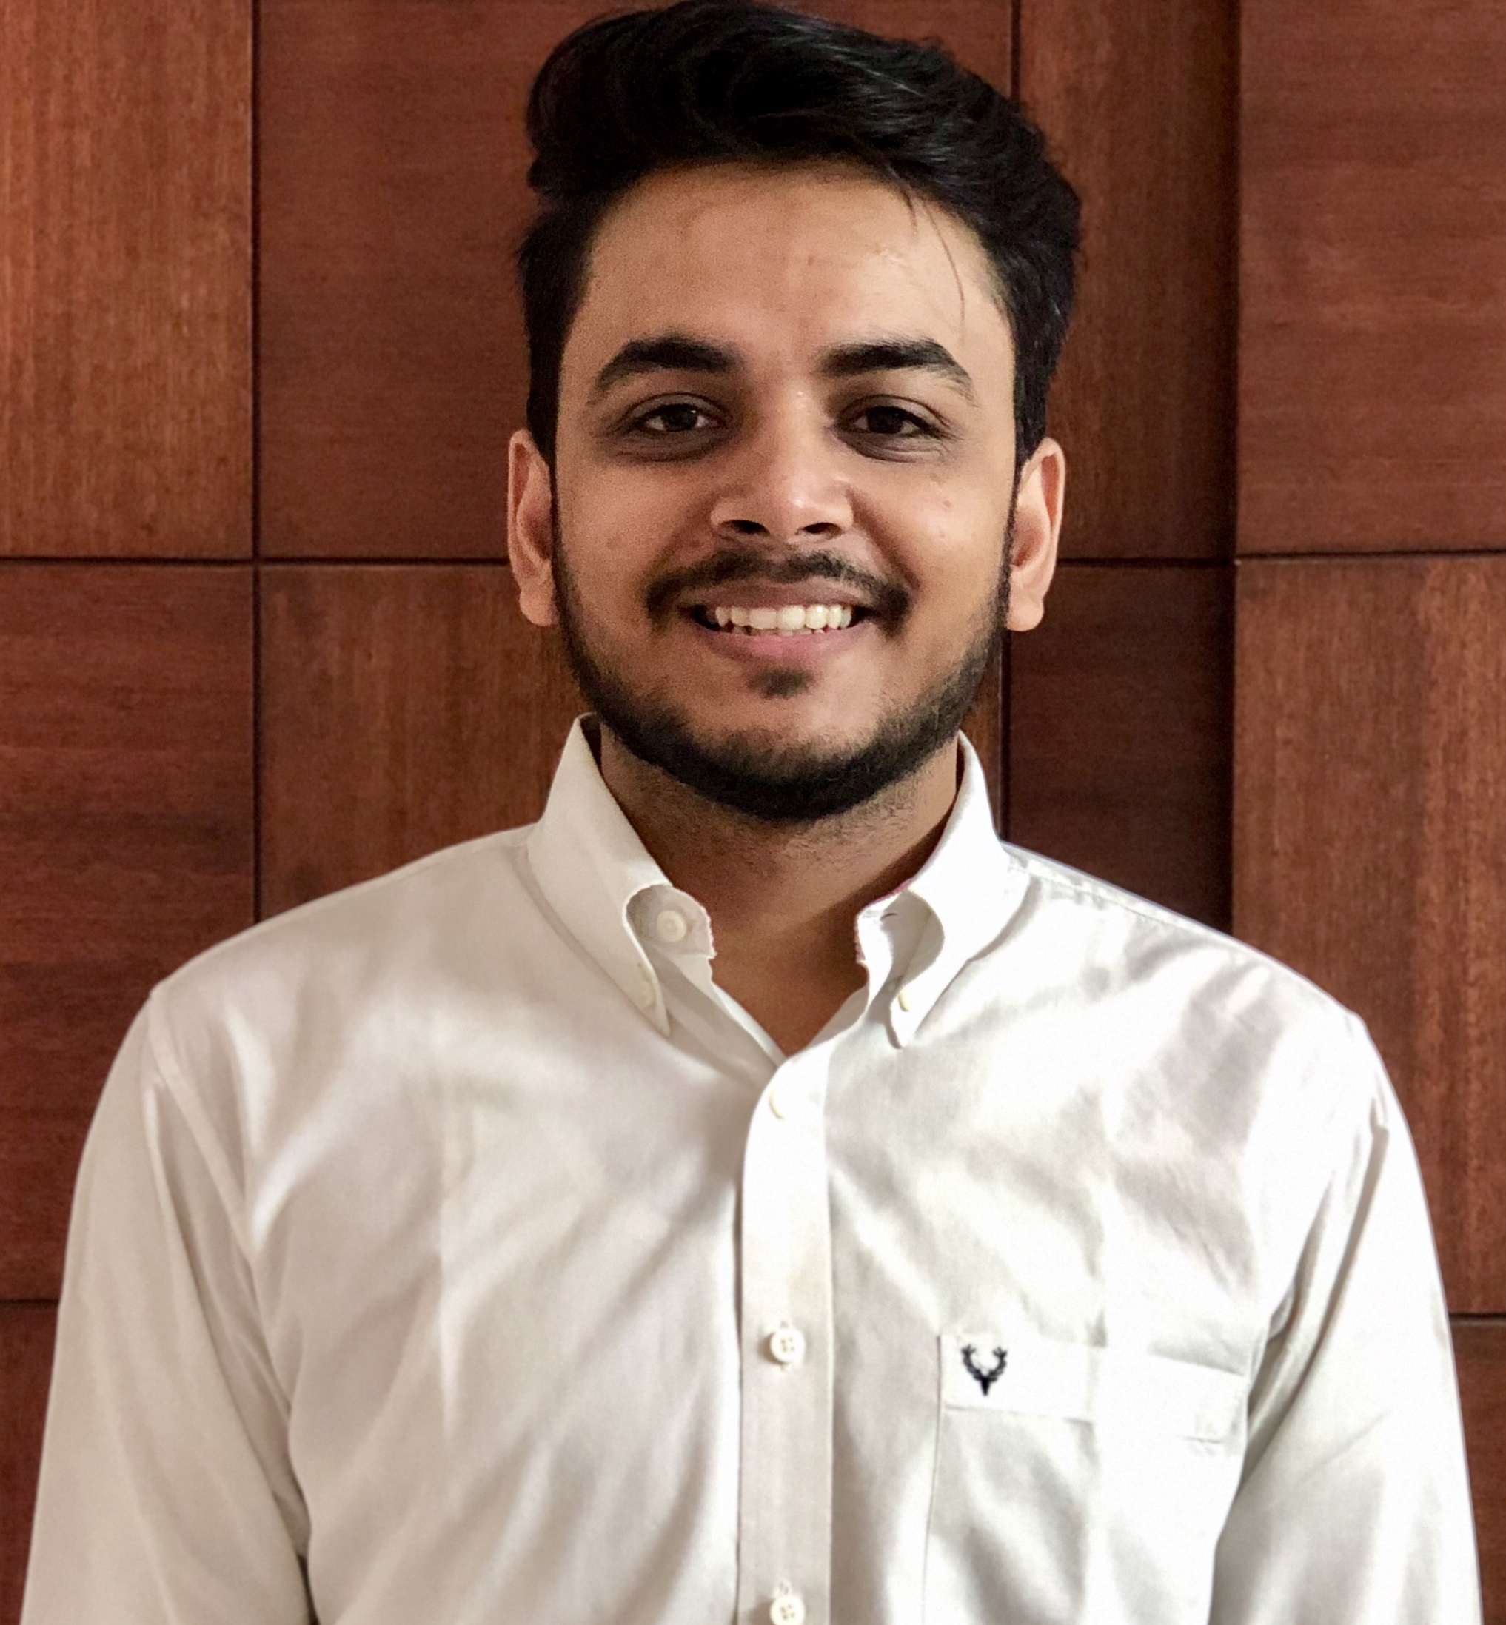




Software Developer, Applied Info Services. Microsoft Business Applications MVP. Flownaut (Power Automate Community SuperUser) Appstronaut (Power Apps Community SuperUser) yashagarwal1651 @gmail.com
Yash Agarwal
@yashagarwal1651
https://bythedevs.com

Slide 8
Schedule for the day
Time | I am a Citizen Developer | I am a Developer
09:30 – 10:00 | Registrations
10:00 – 10:45 | Getting Started + Official launch of Hyderabad Power Apps and Power Automate User Group
11:00 – 11:50 | #PowerPlatform (Yash Agarwal) | Building a custom connector in Power Automate (Satish Reddy)
12:00 – 12:50 | Make your Power App artificially intelligent! (Showndarya Madhavan) | PCF and Re-usable controls in Canvas Apps (Ritika Agarwal)
13:00 – 14:00 | Lunch
14:00 – 14:50 | Bring data at your fingertips using Power Automate! (Showndarya Madhavan) | Power Apps Portals (Ritika Agarwal)
15:00 – 15:50 | Data & Delegation in Apps (Ritika Agarwal) | RPA and Power Automate (Yash Agarwal)
16:00 – 17:00 | Know Your Community & Swag distribution
Notes:
Add your Schedule

Slide 9
House Rules:
Exit
Safety
Premises

Slide 10
Social Media
Our Hashtags:
#GlobalPowerPlatformBootcamp
#GPPB2020
#GPPBHYD
Twitter Handle: @GPPBootcamp
Share Pictures, videos and content: http://bit.ly/GPPBShare
Notes:
Lets Hear from the Global Team, Play video

Slide 11
Hyderabad Power Apps and Power Automate UG
https://powerplatformug.com/Hyderabad
#PowerPlatformUG
#HYDPPUG

Slide 12
Ruffle Draws to win Swags & Prizes

Slide 13
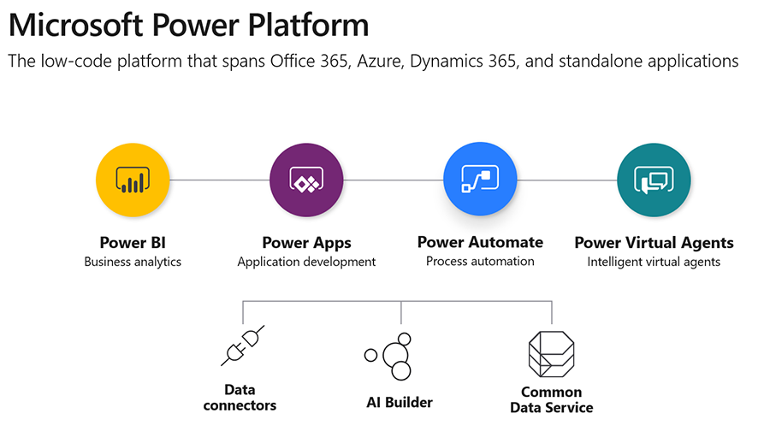
Release Wave I 2020

Slide 14

Please fill out the survey! & Win Swags!! 10 prizes to be Won
https://www.powerplatformbootcamp.com/survey
Notes:
Survey Prizes will be announced on social media, 10 Prizes to be won!

Slide 15
Any Questions?

Slide 16
Kudopalooza Time!

Slide 17
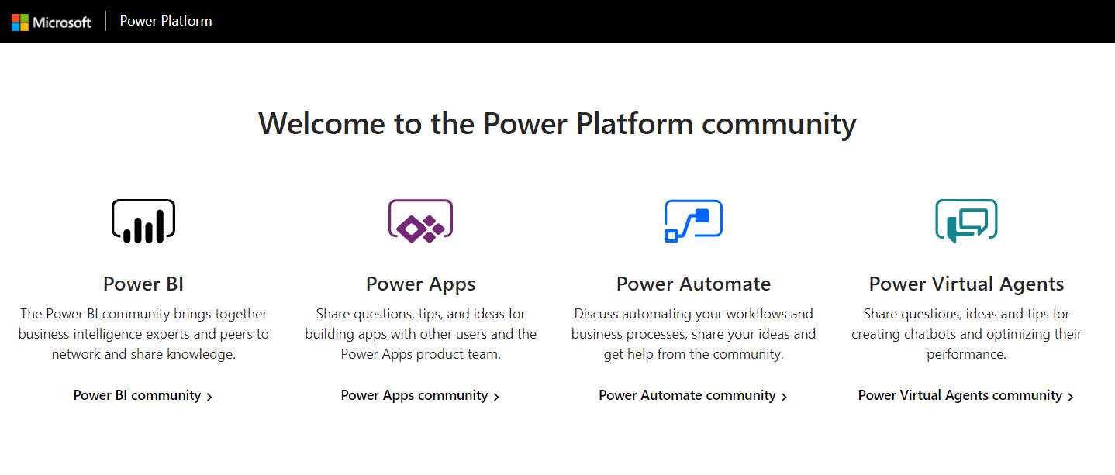
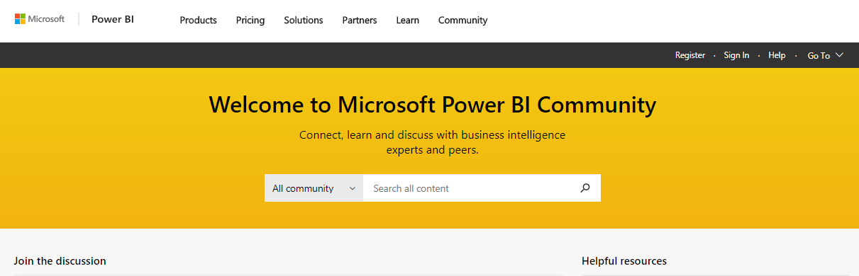

Kudopalooza for SWAG
Navigate to the community:
2. Click Register / Sign In*
3. Search for your event name
4. Click on the post for this event to open it
5. Kudo the post (click the thumbs up) for a chance to win a prize
Community.PowerPlatform.com
1
2
3
*You must Register and sign in to join the fun!

Slide 18

Kudopalooza Winners are…
Notes:
Announce the winners

Slide 19
Have a Great Day!

